Slide 1
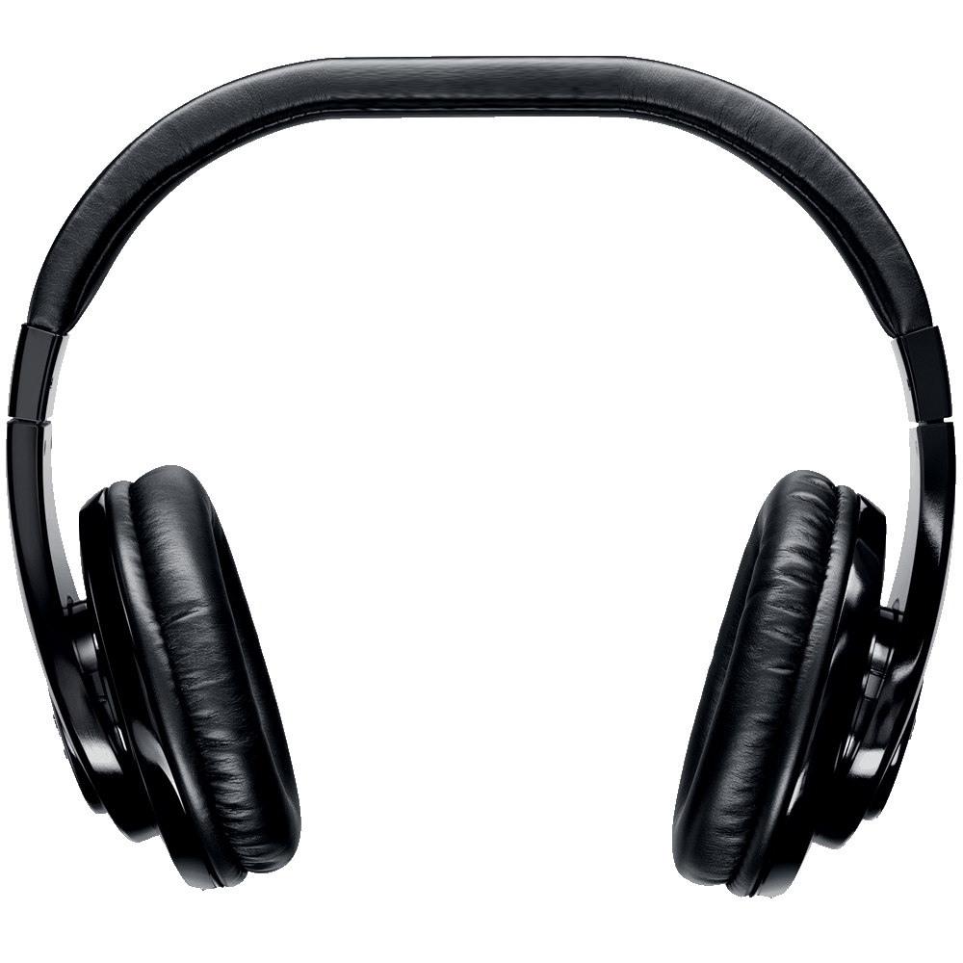
Team MIDI-PoP
Zach Boehm
Andy Ybarra
Brehon Humphrey
Ryan Tenorio
Kyle Mylonakis
Jonathan Sun

Slide 2
“Audio Preview For Venues”
“Venues with assigned seating (i.e. concert halls) sometimes provide view simulations from a given seat to allow customers to determine which seat they’d like to buy a ticket for. However, for a person with a visual disability, the more useful information is how the venue sounds at that location.”
“Develop a system that models the acoustics of a given venue and lets users hear how a clip will sound from a given seat.”

Slide 3
MIDI-PoP Team Members
Ryan Tenorio, MIDI Master
Kyle Mylonakis, Acoustic Consigliere
Brehon Humphrey, Amateur Actor
Zach Boehm, Button Extraordinaire
Andy Ybarra, Applet Maharishi
Jonathan Sun, Vector Visionary

Slide 4
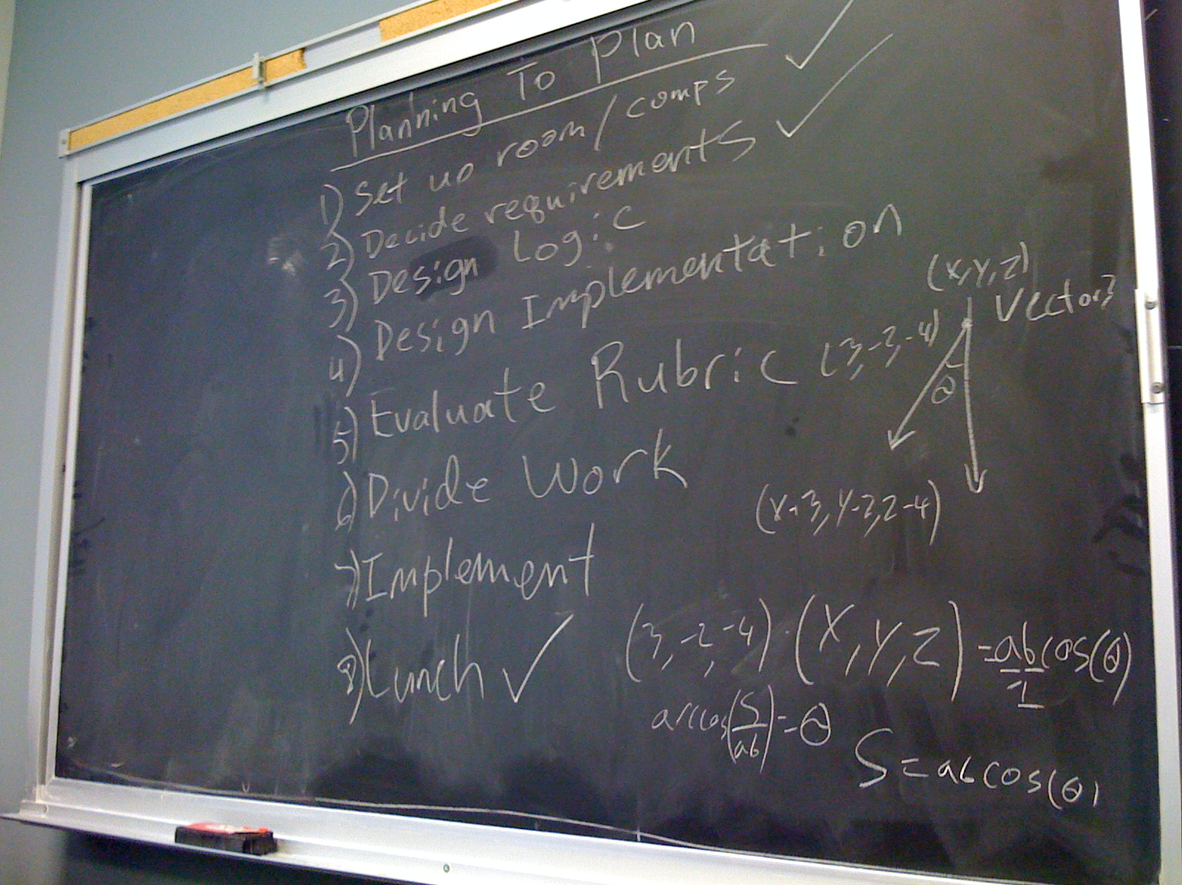
Planning To Plan

Slide 5
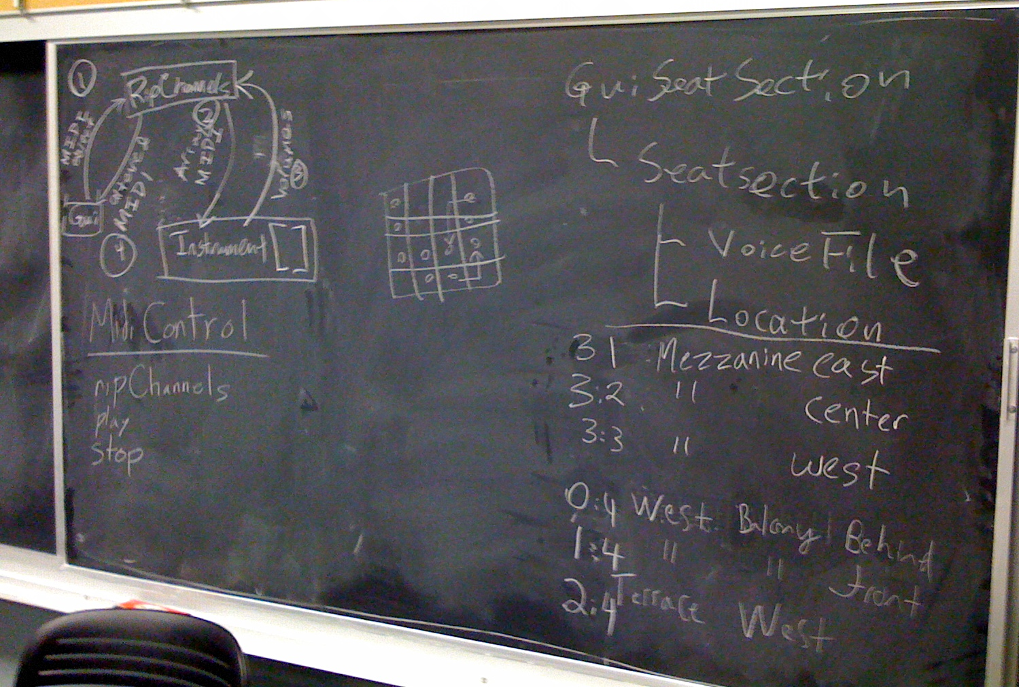
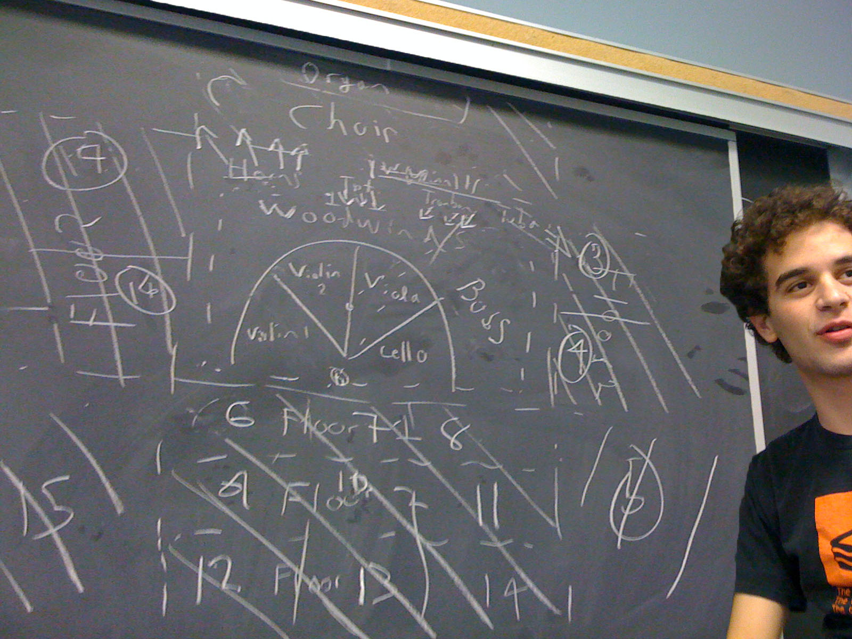
Blueprints

Slide 6
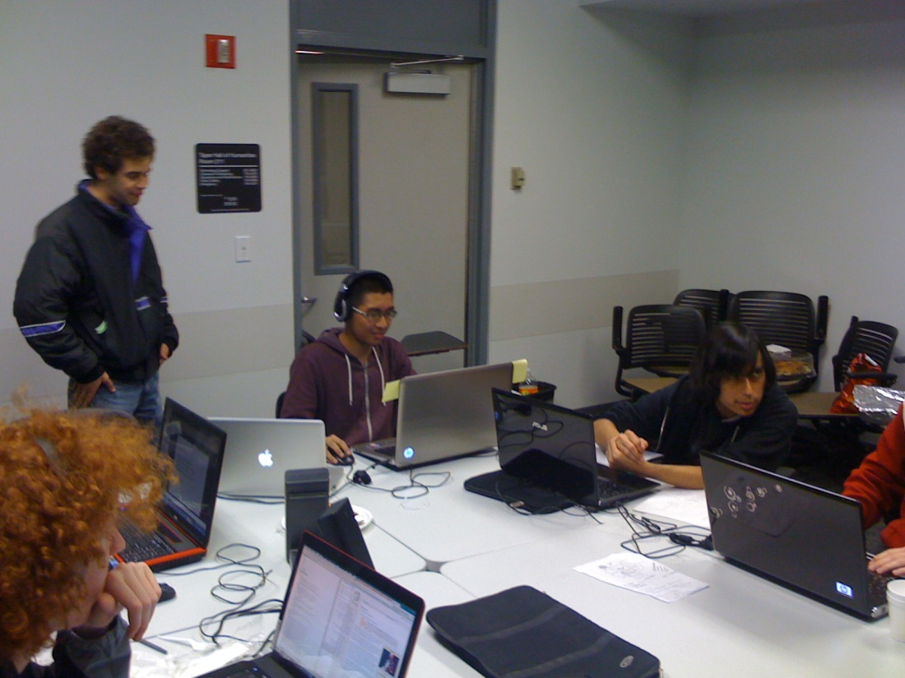
Division
Audio
GUI
Logic

Slide 7
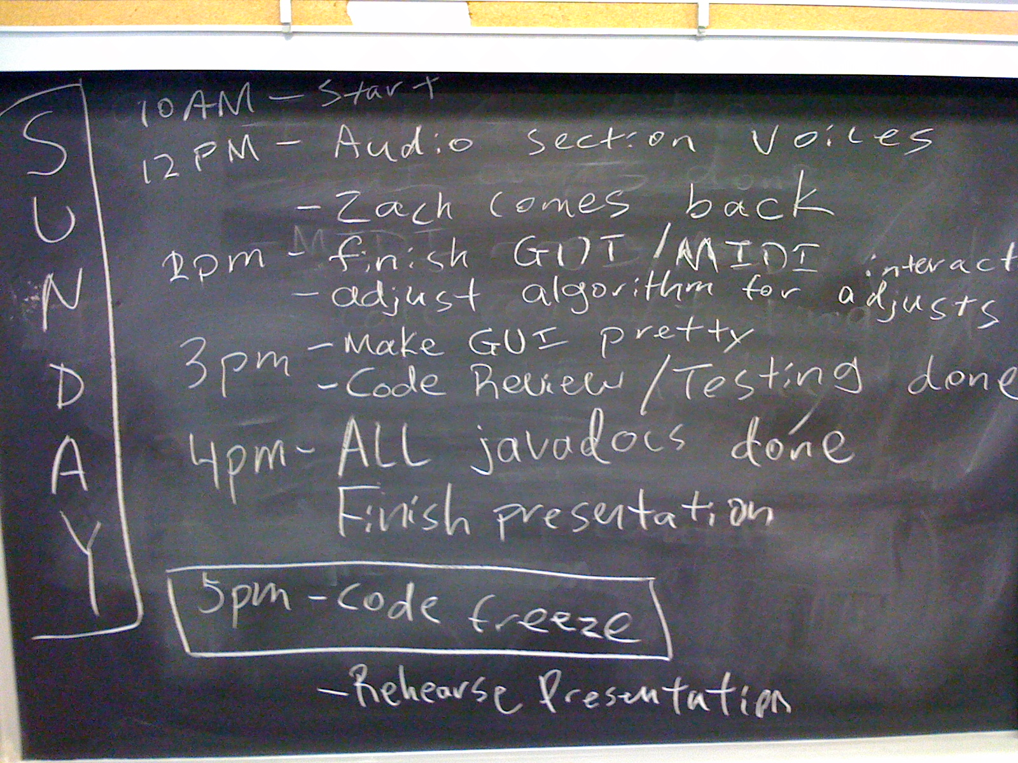
Milestones

Slide 8
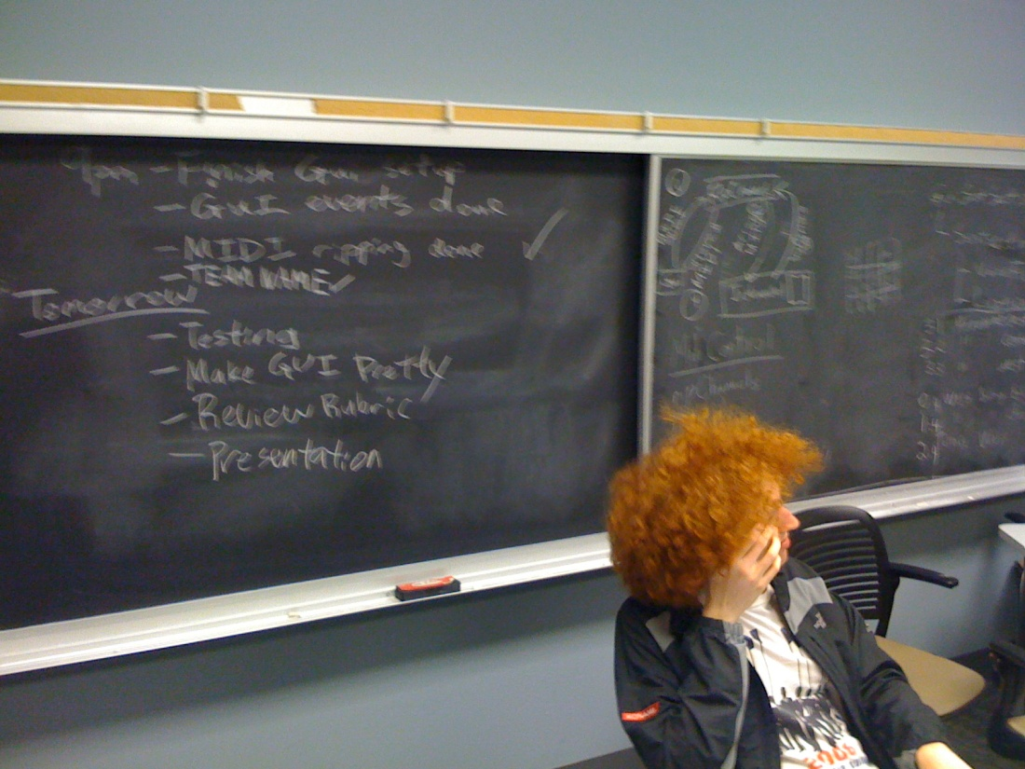
A Weekend of Coding Later…

Slide 9
“SS12_AudioPreview [trunk]”
Total man-hours: 100+
Total lines of code: 1000+
Coded in Java using Subclipse/Tortoise SVN
Number of tree conflicts: …
URL: http://code.google.com/p/ss12-usc-2011-audiopreview2/

